Slide 1
Access Control Lists
Accessing the WAN – Chapter 5

Slide 2
Objectives
Explain how ACLs are used to secure a medium-size Enterprise branch office network.
Configure standard ACLs in a medium-size Enterprise branch office network.
Configure extended ACLs in a medium-size Enterprise branch office network.
Describe complex ACLs in a medium-size Enterprise branch office network.
Implement, verify and troubleshoot ACLs in an enterprise network environment.

Slide 3
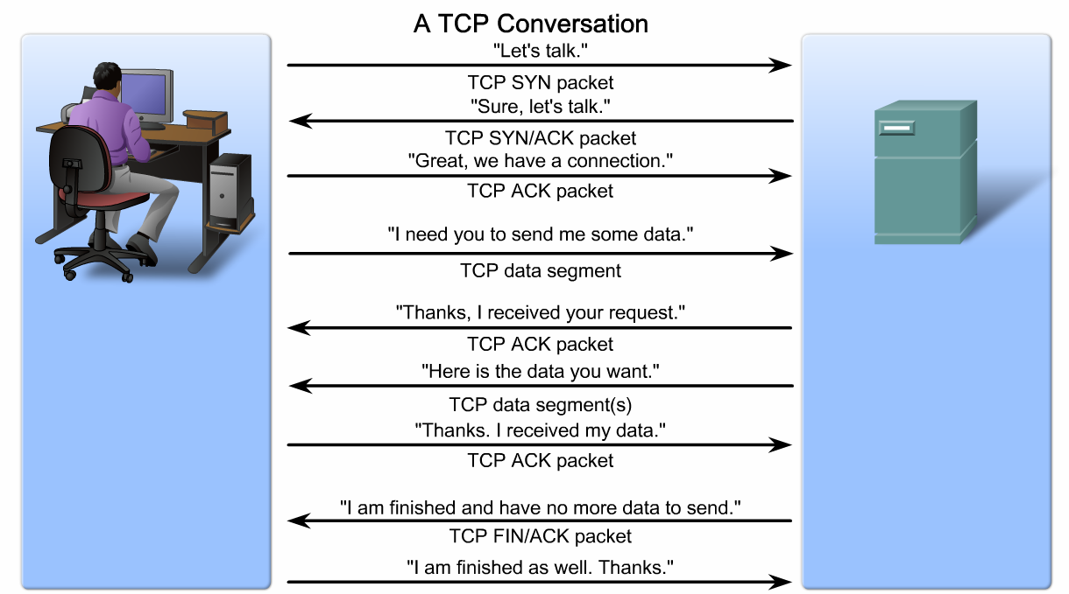
Explain How ACLs are Used to Secure a Medium-Size Enterprise Branch Office Network
Describe the steps that occur in a complete TCP conversation

Slide 4
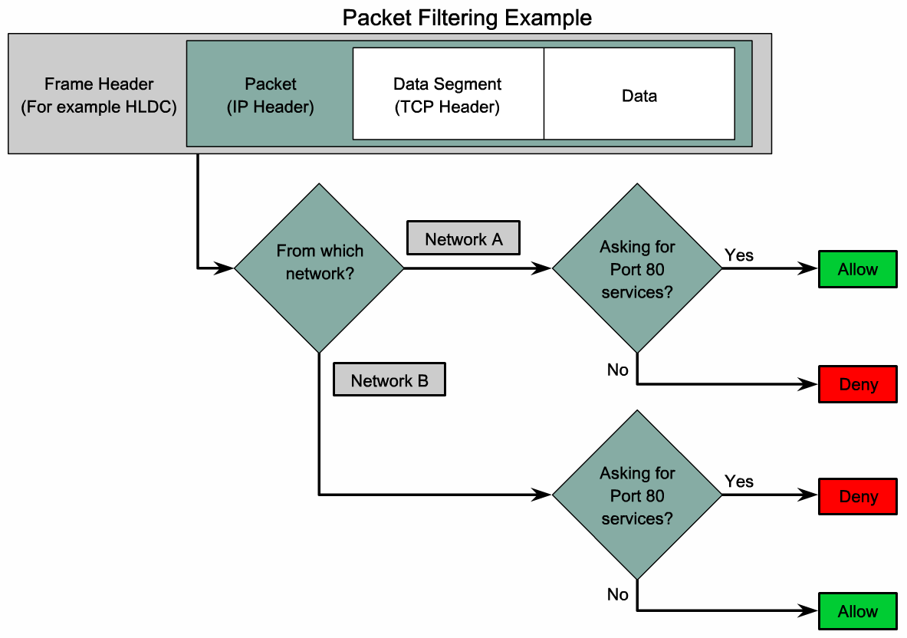
Explain How ACLs are Used to Secure a Medium-Size Enterprise Branch Office Network
Explain how a packet filter allows or blocks traffic

Slide 5
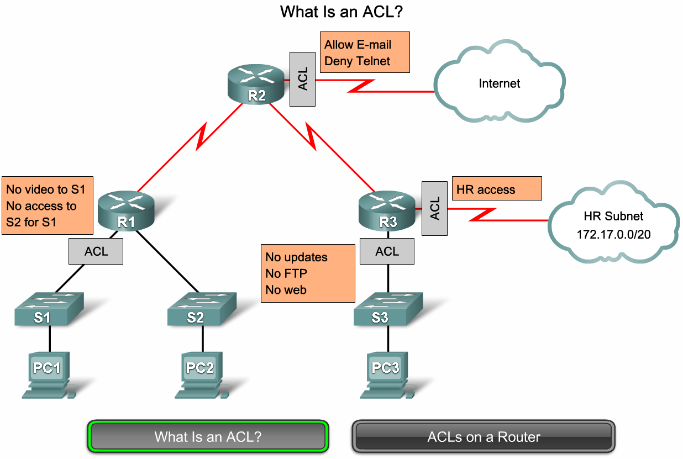
Explain How ACLs are Used to Secure a Medium-Size Enterprise Branch Office Network
Describe how ACLs control access to networks

Slide 6
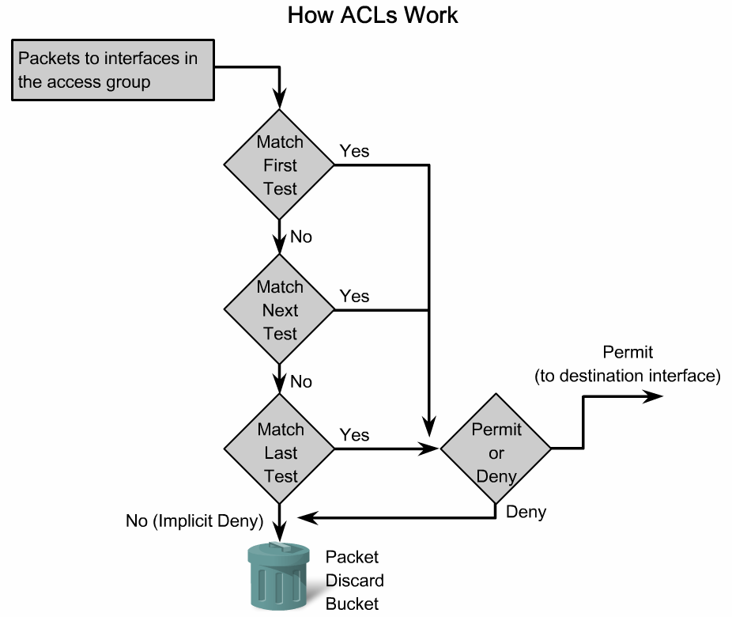
Explain How ACLs are Used to Secure a Medium-Size Enterprise Branch Office Network
Use a flow chart to show how ACLs operate

Slide 7
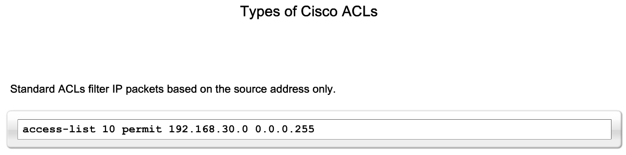
Explain How ACLs are Used to Secure a Medium-Size Enterprise Branch Office Network
Describe the types and formats of ACLs

Slide 8
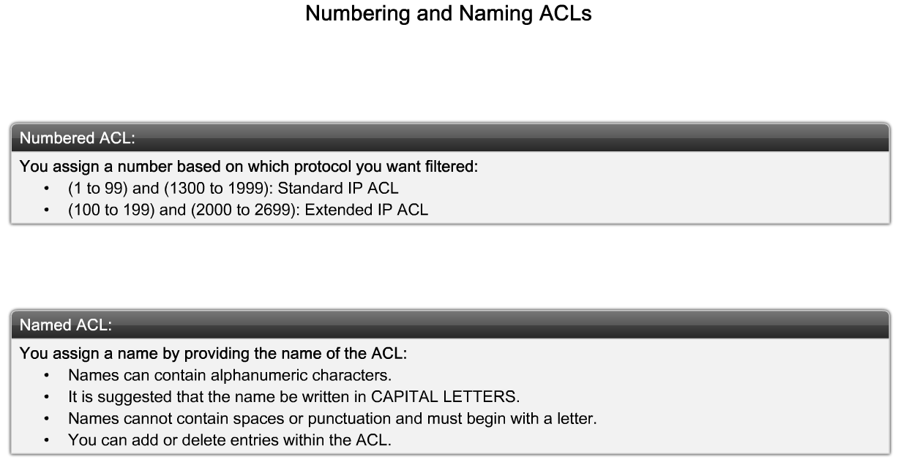
Explain How ACLs are Used to Secure a Medium-Size Enterprise Branch Office Network
Explain how Cisco ACLs can be identified using standardized numbering or names

Slide 9
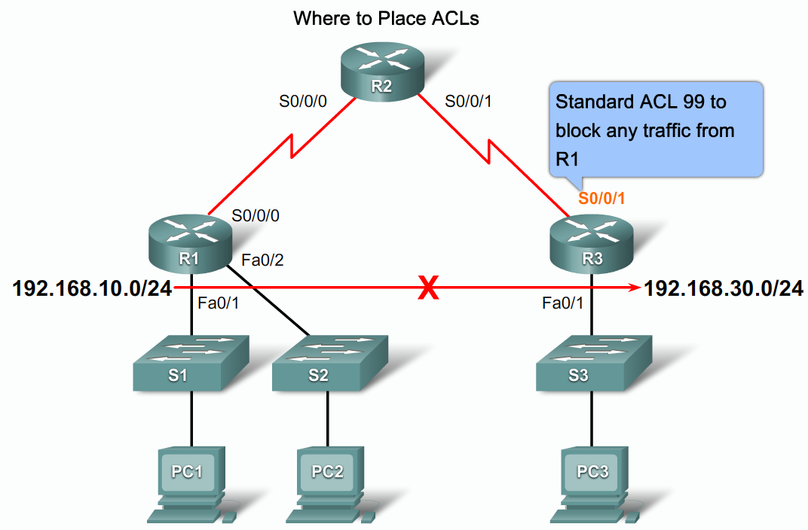
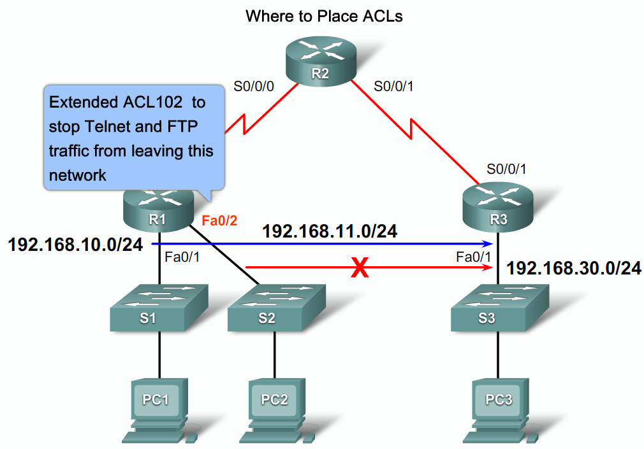
Explain How ACLs are Used to Secure a Medium-Size Enterprise Branch Office Network
Describe where ACLs should be placed in a network

Slide 10
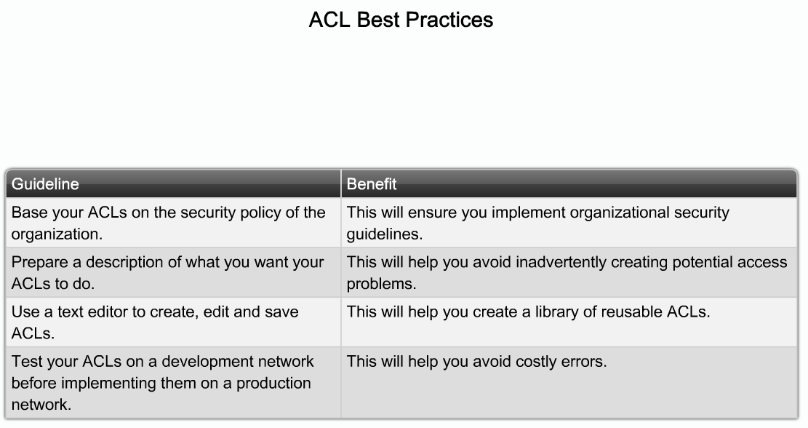
Explain How ACLs are Used to Secure a Medium-Size Enterprise Branch Office Network
Explain the considerations for creating ACLs

Slide 11
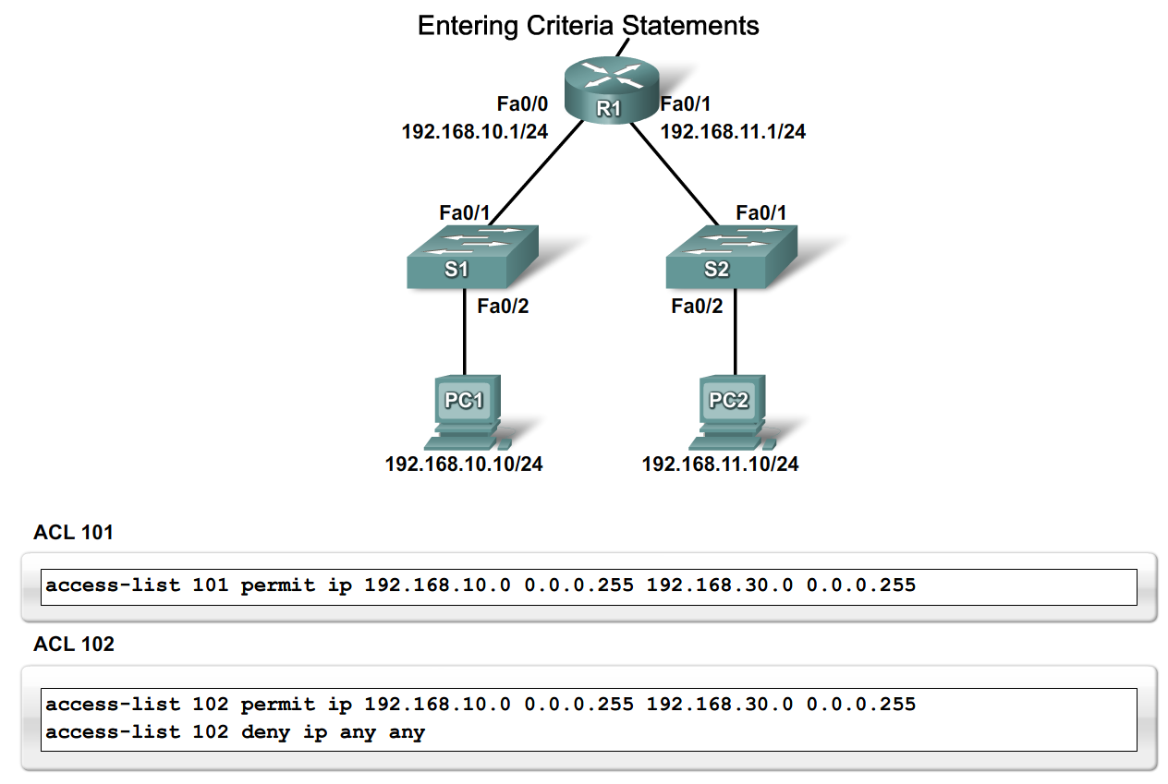
Configure Standard ACLs in a Medium-Size Enterprise Branch Office Network
Explain why the order in which criteria statements are entered into an ACL is important

Slide 12
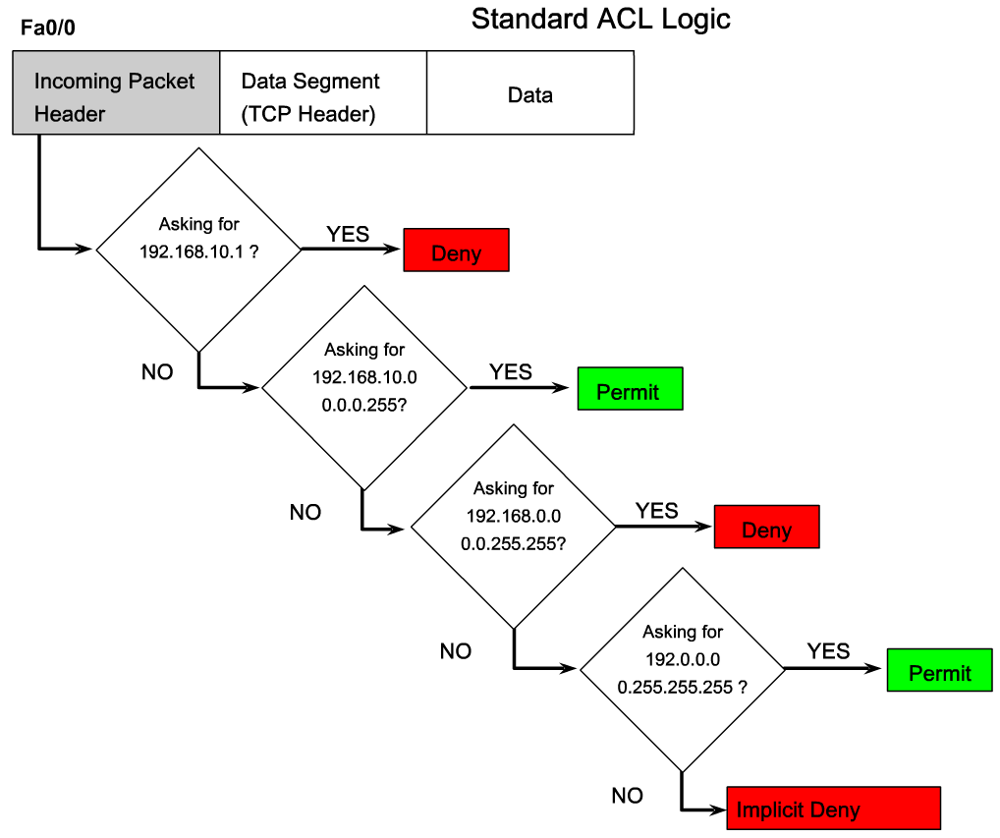
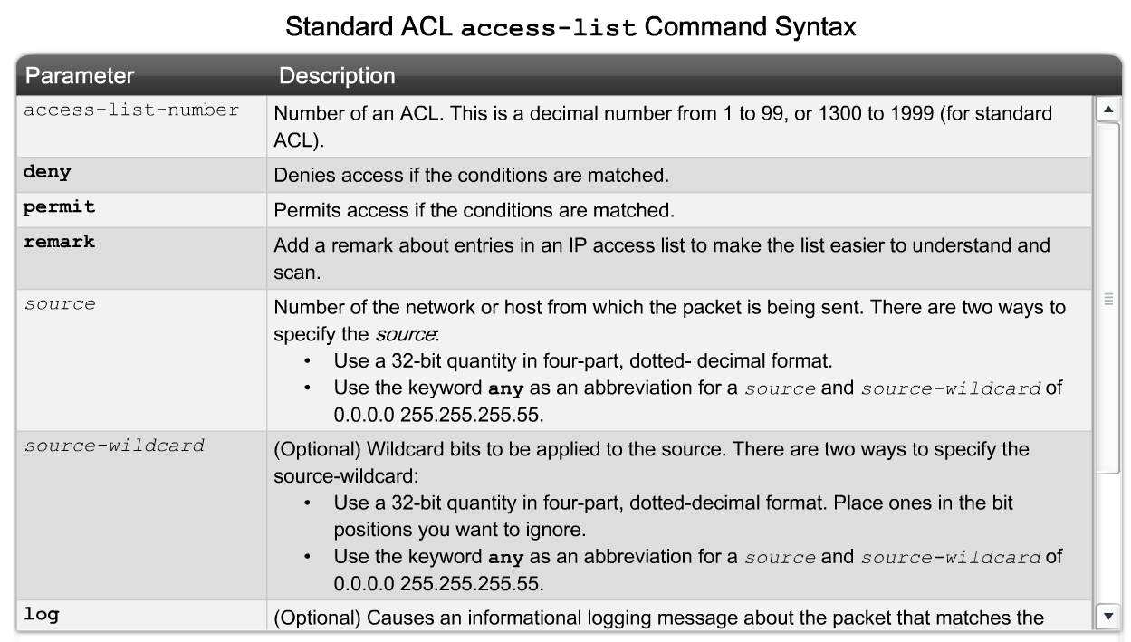
Configure Standard ACLs in a Medium-Size Enterprise Branch Office Network
Explain how to configure a standard ACL

Slide 13
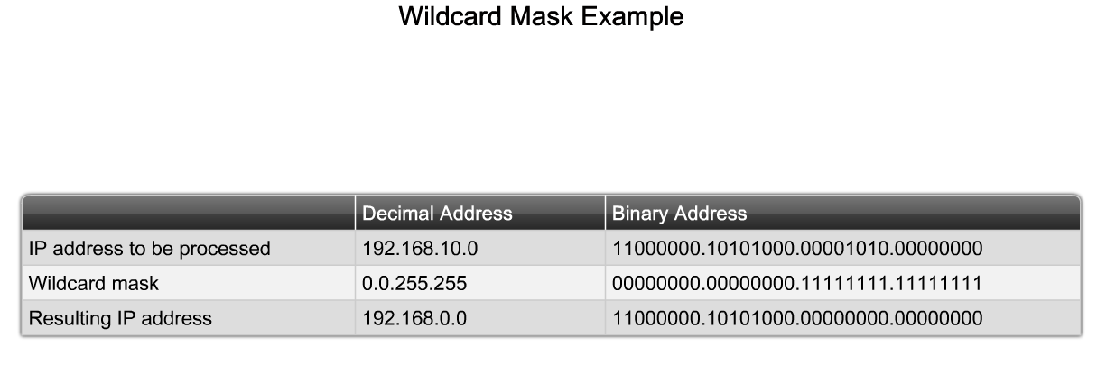
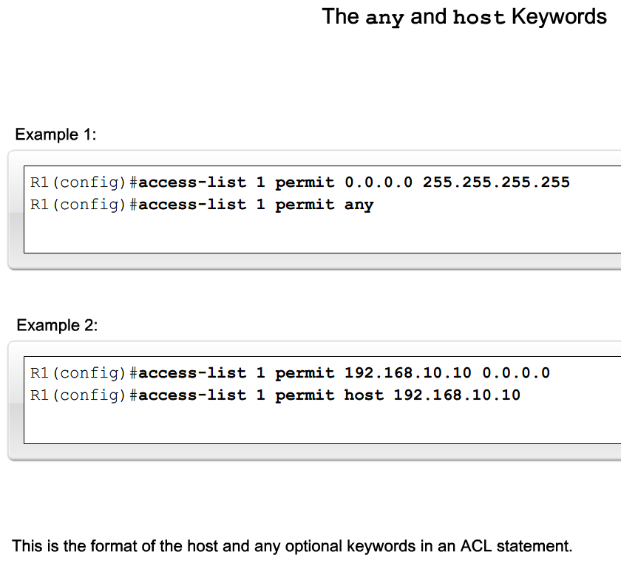
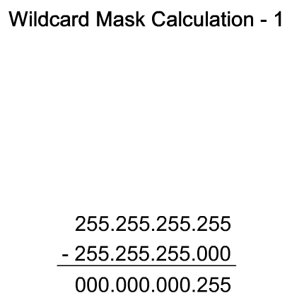
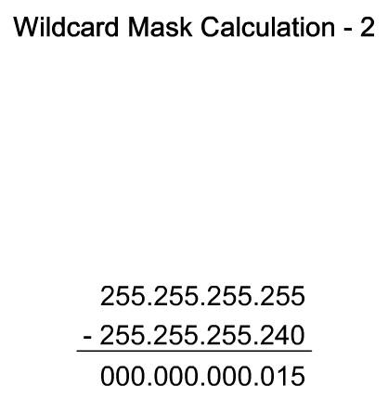
Configure Standard ACLs in a Medium-Size Enterprise Branch Office Network
Describe how to use wildcard masks with ACLs

Slide 14
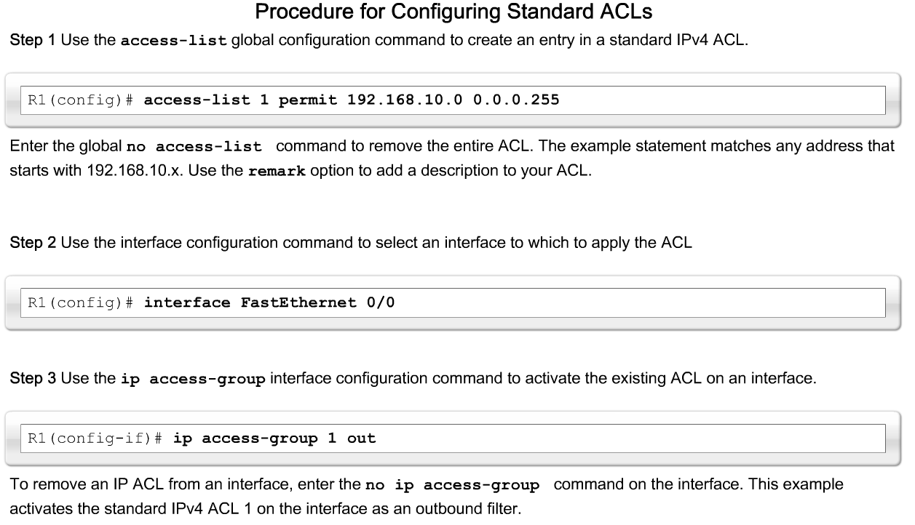
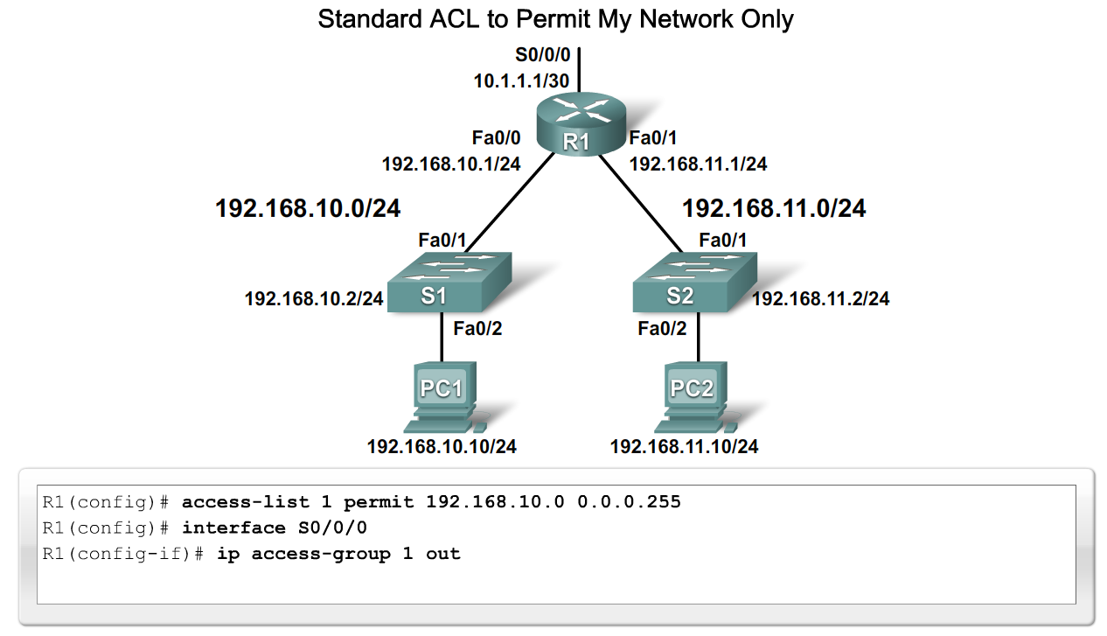
Configure Standard ACLs in a Medium-Size Enterprise Branch Office Network
Describe how to apply a standard ACL to an interface

Slide 15
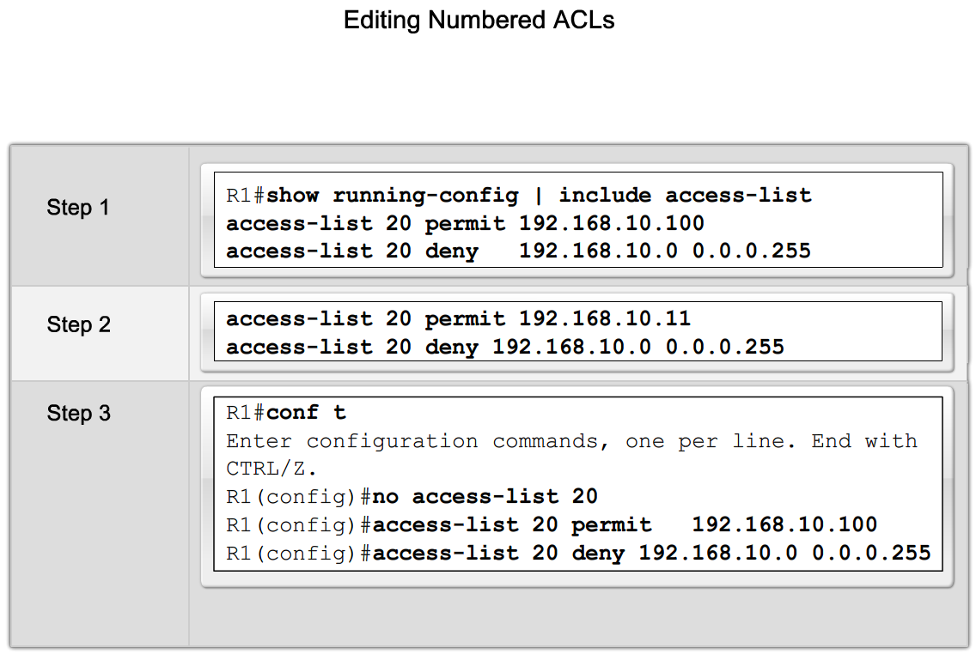
Configure Standard ACLs in a Medium-Size Enterprise Branch Office Network
Explain the process for editing numbered ACLs

Slide 16
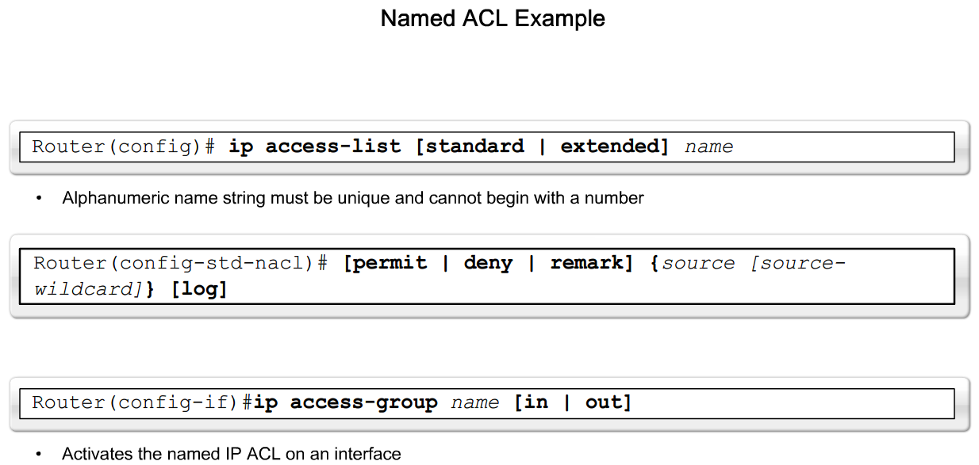
Configure Standard ACLs in a Medium-Size Enterprise Branch Office Network
Explain how to create a named ACL

Slide 17
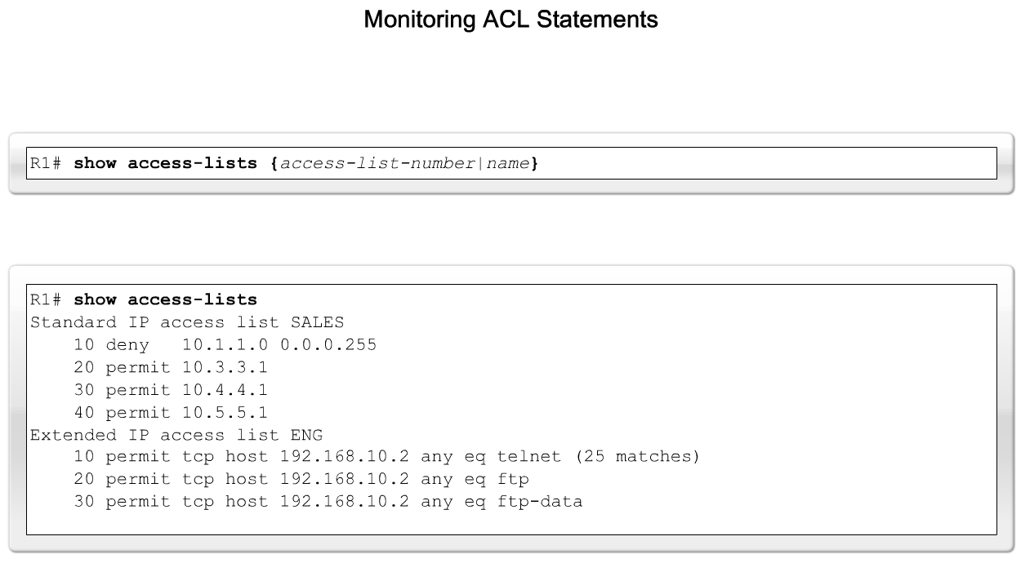
Configure Standard ACLs in a Medium-Size Enterprise Branch Office Network
Describe how to monitor and verify ACLs

Slide 18
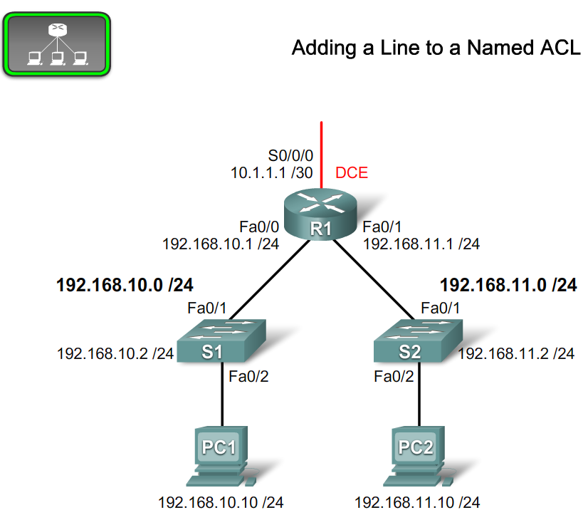
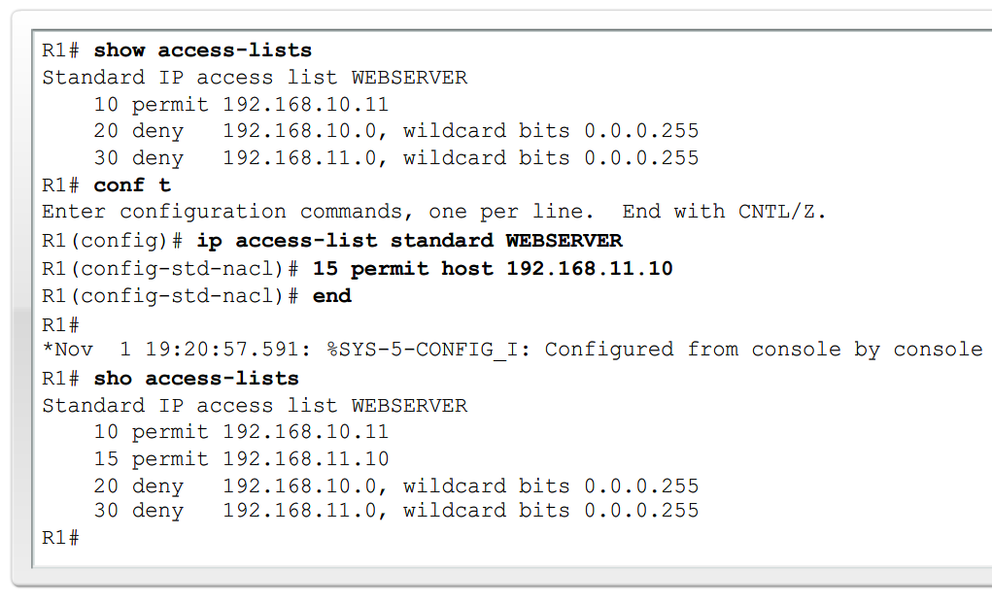
Configure Standard ACLs in a Medium-Size Enterprise Branch Office Network
Explain the process for editing named ACLs

Slide 19
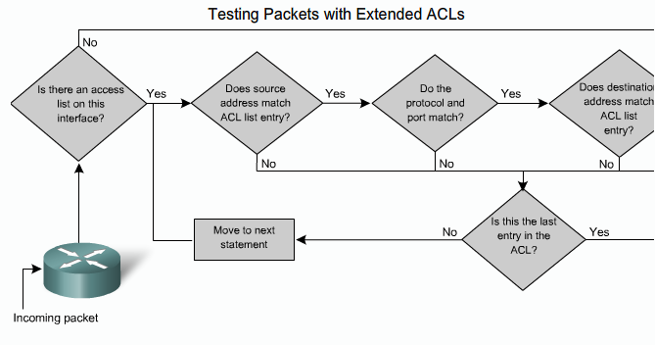
Configure Extended ACLs in a Medium-Size Enterprise Branch Office Network
Explain how an extended ACL provides more filtering then a standard ACL

Slide 20
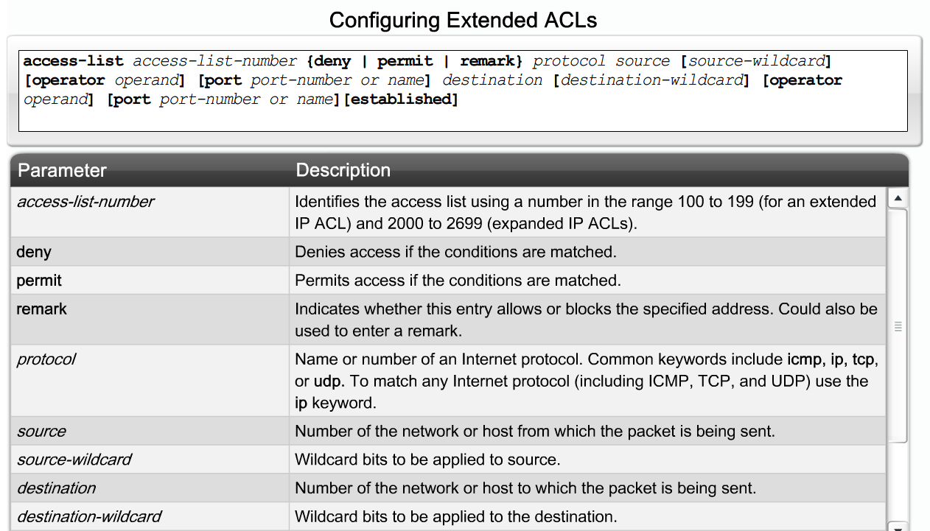
Configure Extended ACLs in a Medium-Size Enterprise Branch Office Network
Describe how to configure extended ACLs

Slide 21
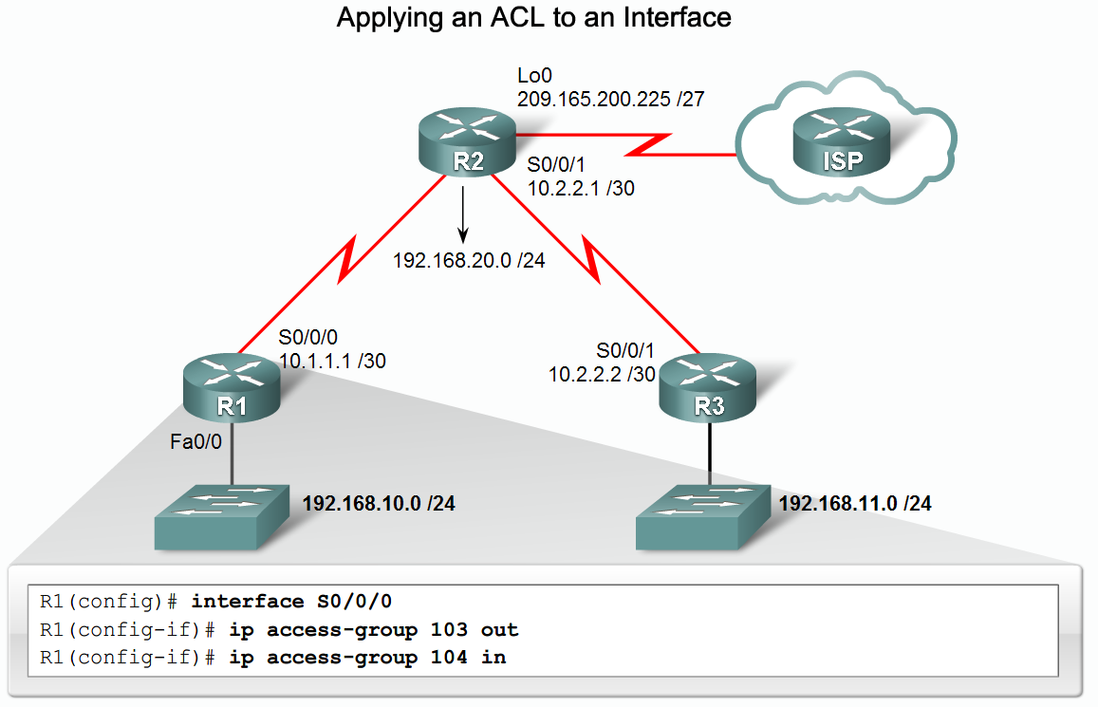
Configure Extended ACLs in a Medium-Size Enterprise Branch Office Network
Describe how to apply an extended ACL to an interface

Slide 22
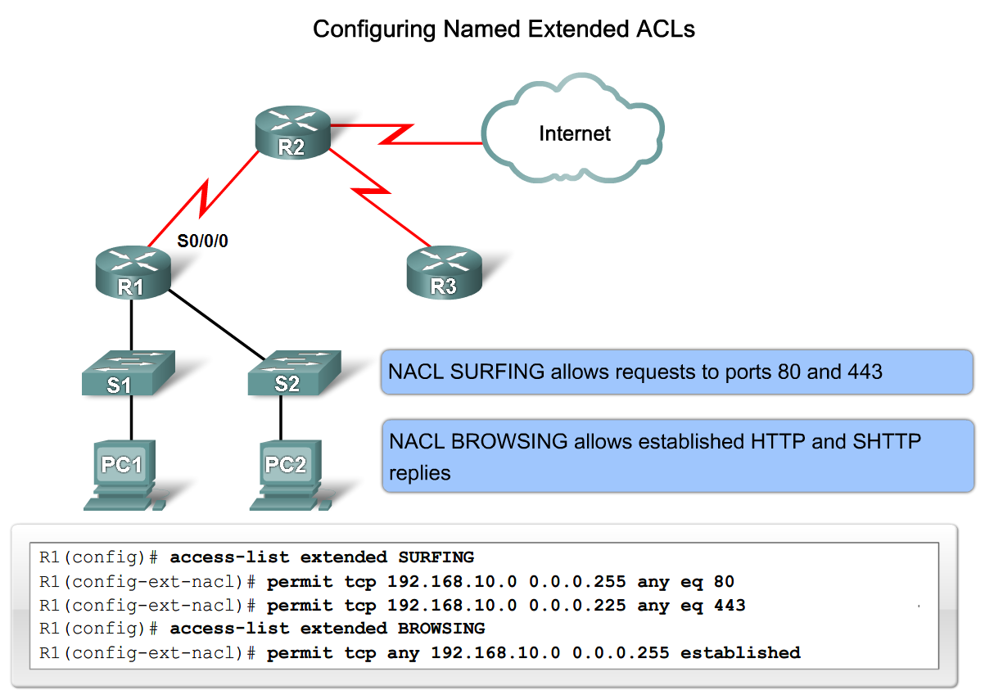
Configure Extended ACLs in a Medium-Size Enterprise Branch Office Network
Describe how to create named extended ACLs

Slide 23
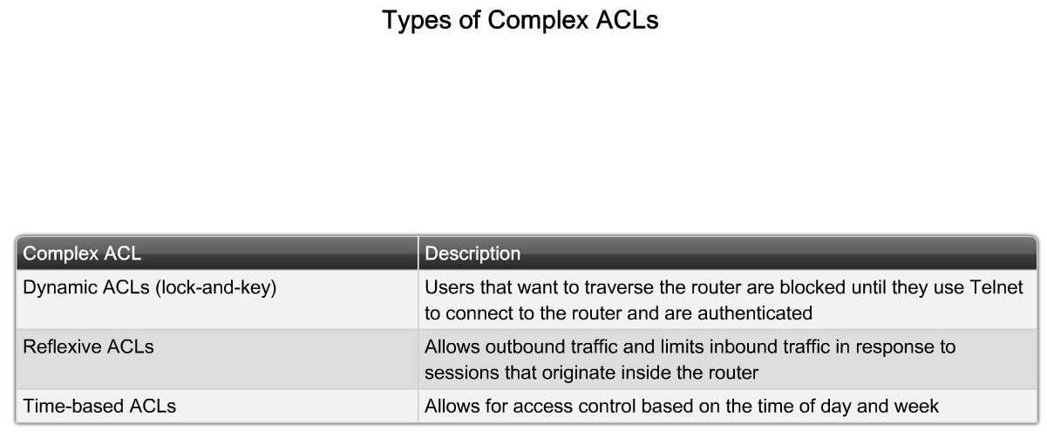
Describe Complex ACLs in a Medium-Size Enterprise Branch Office Network
List the three types of complex ACLs

Slide 24
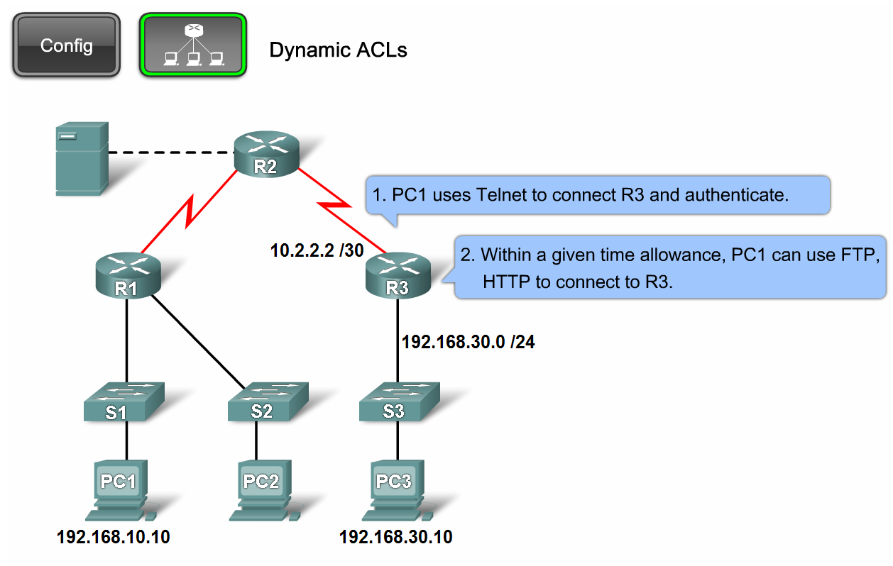
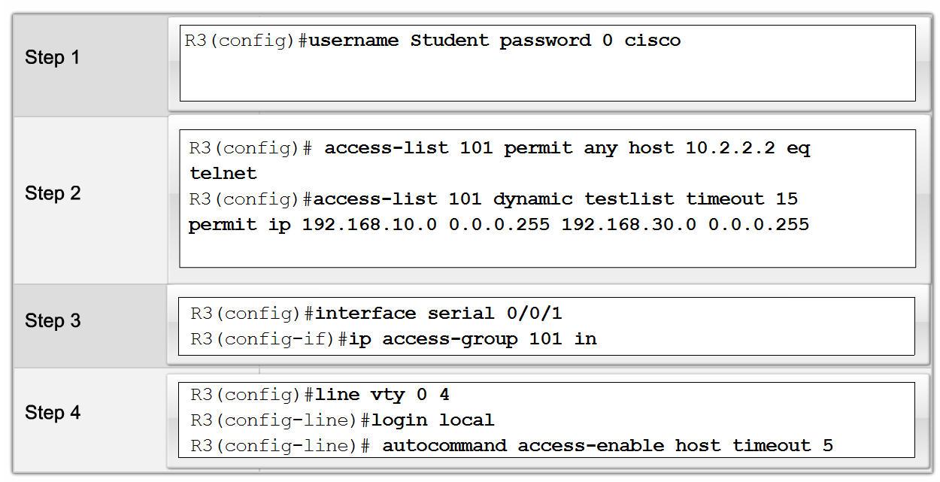
Describe Complex ACLs in a Medium-Size Enterprise Branch Office Network
Explain how and when to use dynamic ACLs

Slide 25
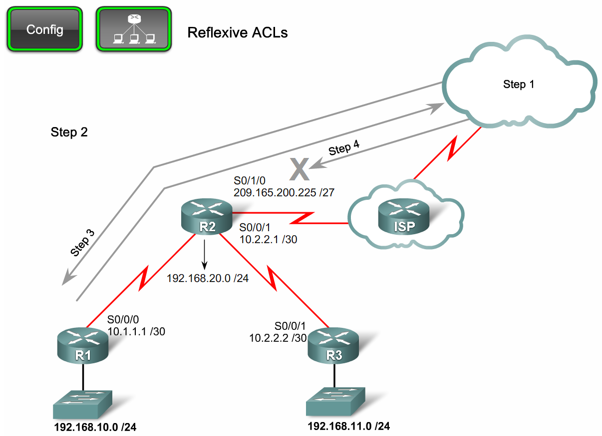
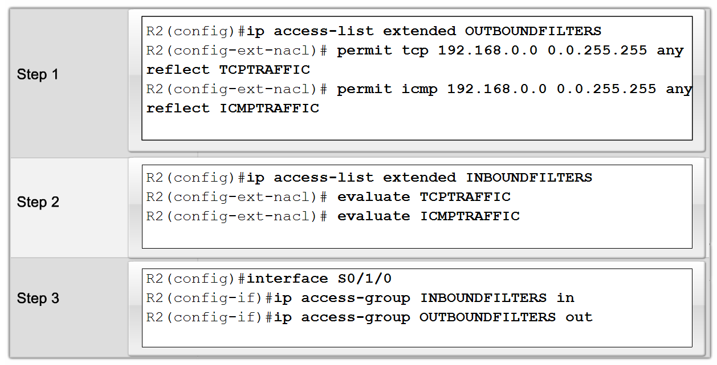
Describe Complex ACLs in a Medium-Size Enterprise Branch Office Network
Explain how and when to use reflexive ACLs

Slide 26
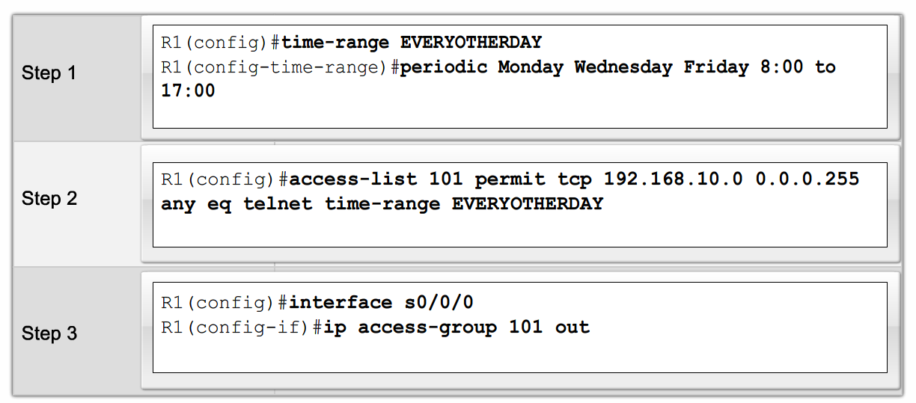
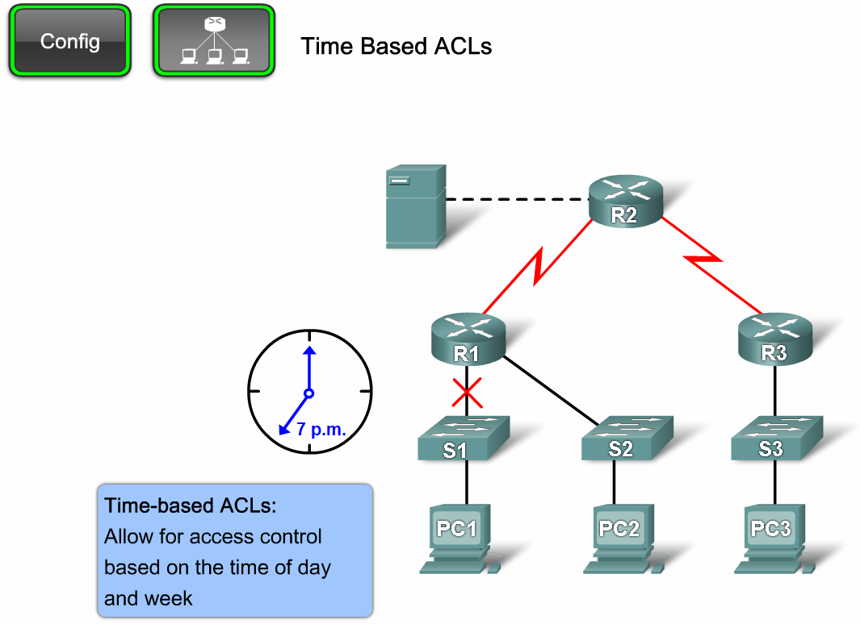
Describe Complex ACLs in a Medium-Size Enterprise Branch Office Network
Explain how and when to use time-based ACLs

Slide 27
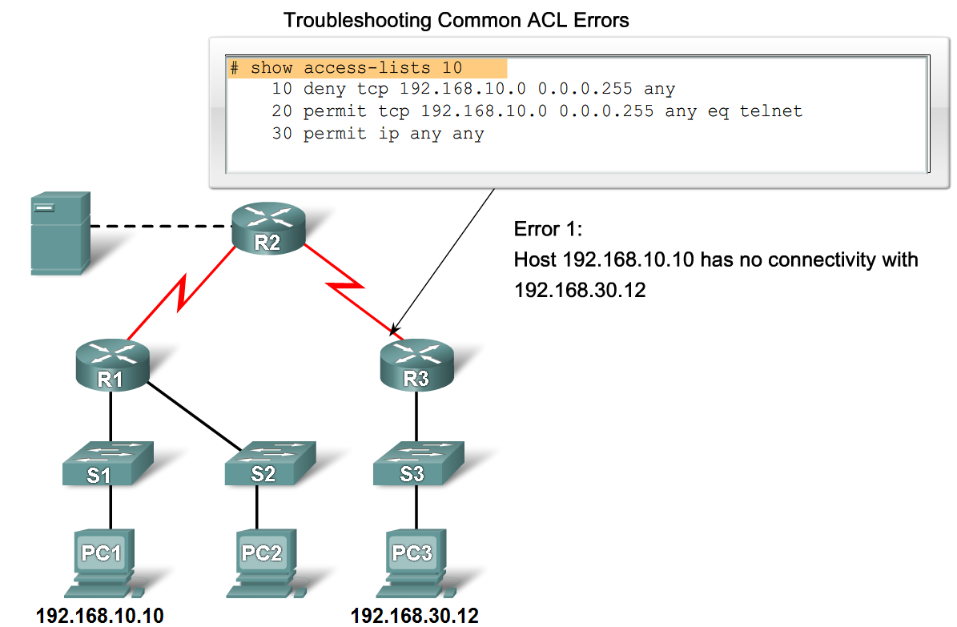
Describe Complex ACLs in a Medium-Size Enterprise Branch Office Network
Describe how to troubleshoot common ACL problems

Slide 28
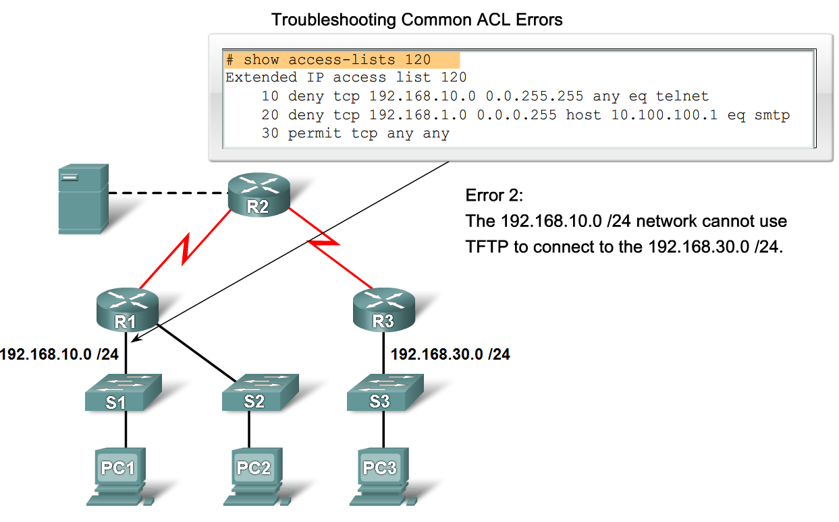
Implement, Verify and Troubleshoot ACLs in an Enterprise Network Environment
Create, place and verify a standard/ extended ACL and verify its placement.
Verify ACL’s functionality and troubleshoot as needed.

Slide 29
Summary
An Access List (ACL) is:
  A series of permit and deny statements that are used to filter traffic
Standard ACL
  Identified by numbers 1 - 99 and 1300 - 1999
  Filter traffic based on source IP address
Extended ACL
  Identified by number 100 -199 & 2000 - 2699
  Filter traffic based on
    Source IP address
    Destination IP address
    Protocol
    Port number

Slide 30
Summary
Named ACL
  Used with IOS 11.2 and above
  Can be used for either standard or extended ACL
ACL’s use Wildcard Masks (WCM)
  Described as the inverse of a subnet mask
    Reason
      0 → check the bit
      1 → ignore the bit

Slide 31
Summary
Implementing ACLs
  1st create the ACL
  2nd place the ACL on an interface
    Standard ACL are placed nearest the destination
    Extended ACL are placed nearest the source
Use the following commands for verifying & troubleshooting an ACL
  Show access-list
  Show interfaces
  Show run

Slide 32
Summary
Complex ACL
  Dynamic ACL
  Reflexive ACL
  Time based ACL

